Slide 1

1
Department of Computer Engineering
PCET’s Pimpri Chinchwad College of Engineering
Idea Incubation using Social Network Innovation
with Talent Recognition
Om Gupta 120B1B161
Bhushan Patil 120B1B166
Ruchi Thakkar 120B1B223
Mehak Chib 120B1B229
Under the guidance of
Prof. Ganesh Deshmukh

Slide 2
Introduction
In today's digital world, generating ideas is easy, but bringing them to life often requires skilled collaborators. We propose a novel approach to foster idea incubation within a social network. By analyzing user data and understanding their personalities, we aim to connect individuals with the right skills and mindset for collaboration. Through this approach, we strive to create a dynamic platform where diverse talents can come together, optimize collaboration potential, and nurture innovative ideas.

Slide 3
Objectives
1. Industry:
- Develop a scalable platform using data analysis and psychometrics to connect professionals, fostering collaborative innovation in tailored industries.
2. Research:
- Integrate psychometric assessments into a social network framework to advance understanding of talent recognition's role in collaborative innovation.
3. Product:
- Build a user-friendly, privacy-focused product facilitating personalized collaboration, connecting users for efficient idea incubation and innovation.

Slide 4
Literature Survey
Sr No | Title | Methadology | Strengths | Weakness
1. | Research on the Improved Word2Vec Optimization Strategy Based on Statistical Language Model (2020) | The methodology of this study involves enhancing the Word2Vec algorithm for short text classification, validated through empirical testing on real data and evaluated using precision, recall rate, and F-value metrics. | Its strengths lie in its innovative approach, demonstrating improved performance over existing methods, and potential for practical application in real-world text classification tasks | The study's limitations include a lack of exploration of alternative algorithms, potential complexity, computational overhead, and a need for deeper analysis or comparison with other approaches.
2. | An Improved Louvain Algorithm for Community Detection (2021) | The study develops the Fast Louvain algorithm through a review of existing methods and experimental validation on diverse datasets. | The research contributes a novel algorithm, Fast Louvain, enhancing community detection efficiency and accuracy through dynamic iteration and tree structure splitting. | The study's reliance on modularity as the main evaluation metric and limited comparison to alternative algorithms may restrict broader insights into community structure detection.

Slide 5
Sr No | Title | Methadology | Strengths | Weakness
3. | A Survey of Word Mover's Distance (2022) | The paper covers the theory behind WMD and its ties to optimal transportation theory It examines WMD's diverse applications across fields like NLP, computer vision, and music analysis, with a focus on tasks such as text retrieval, document ranking, and question answering. | The paper highlights the advantages of WMD, such as its ability to capture semantic relationships and handle different word lengths. WMD is less sensitive to outliers and typos compared to methods like exact word matching. | Limitations like computational complexity and sensitivity to word order are also discussed. The order of words within documents can slightly affect WMD scores, potentially impacting some tasks.
4. | Large Language Models for Information Retrieval: A Survey (2024) | The paper focuses on understanding complex semantic nuances in queries and documents, generating more relevant and accurate results, tailoring results based on user preferences. It surveys the landscape of LLM applications in IR, highlighting promising directions and key challenges. | Integrating LLMs with traditional IR methods for optimal results. Addressing different combinations of encoders and decoders for specific use cases. Fine tuning can help save a lot of resources. | Weak queries can misguide the LLM and give inaccurate results. Reducing bais and new model training cost still remains a big challenge. Due to the nodal structure of the LLMs, its difficult to understand how decisions are made.

Slide 6
Software Requirements
TensorFlow for deep learning model development.
Google Colab, a cloud-based Jupyter notebook environment.
Jupyter Notebook for interactive coding and experimentation.
React for building the web application.
Web server for deploying the application.
Python as the primary programming language

Slide 7
Modules
Dataset Creation and Weight Assignment
Tags Extraction and Community Detection
3. UI and Ranking
4. Information Retreival and Generative AI

Slide 8
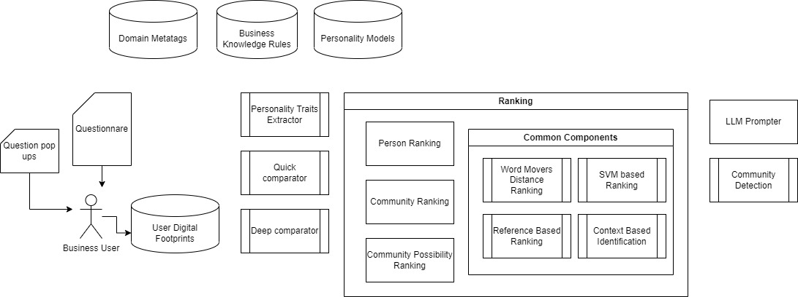
System Architecture

Slide 9
Algorithmic Survey and Implementation

Slide 10
Dataset Creation
LinkedIn dataset consists of 1000 rows and 26 columns.
Columns of the dataset includes
['id’,'name', 'city', 'country_code', 'region', 'current_company:name’,'position', 'following', 'about’, 'experience’, 'educations_details’,'languages', 'certifications’,
'сourses’…]
Using Selenium crawler

Slide 11
UI and Ranking
UI is made using Figma which will be converted to React code.
Ranking Algorithms:
1. SVM Ranking
2. Word Mover’s Distance
3. BERT

Slide 12
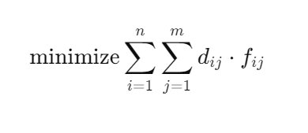
Word Mover’s Distance
WMD calculates the semantic distance between documents by measuring the minimum "traveling distance" of words.
WMD ranks documents by their similarity to a given query. Documents with lower WMD scores are ranked higher, ensuring that closely related documents are prioritized.
We can formulate WMD as an optimization problem to find the minimum distance required to move words from Document A to Document B:

Slide 13
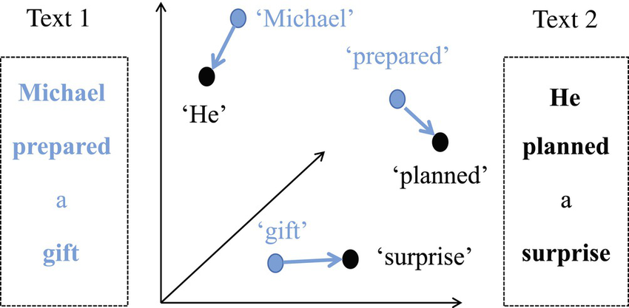

Slide 14
Community Detection Algorithms
Gerwan Newman Algorithm
Louvain Algorithm
Label Propagation Algorithm

Slide 15
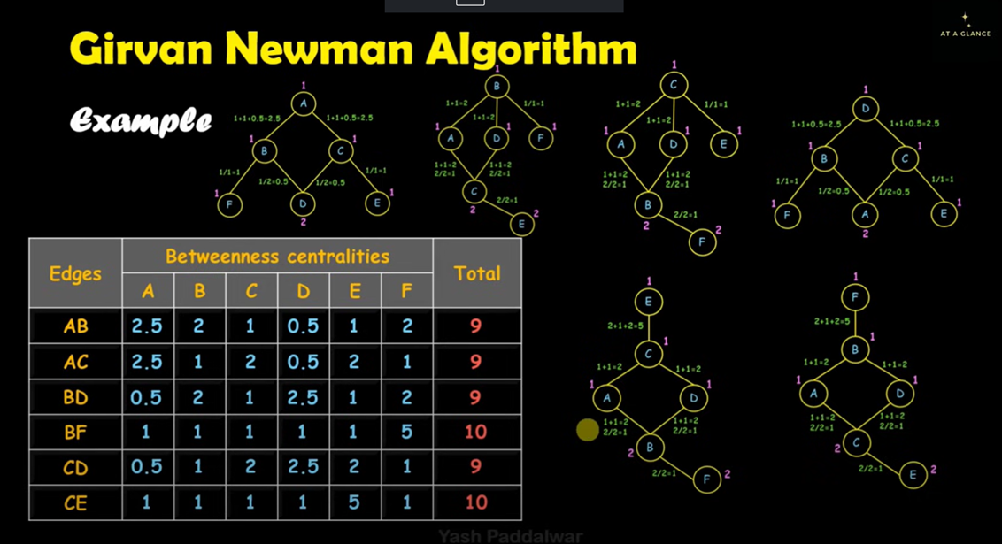
Gerwan Newman Algorithm
In this algorithm we calculate the edge betweenness of each of edge.
Remove the edge having the highest edge betweenness, which leds to formation of communities.
We repeat the same step until we reach a position where all the edges have same betweenness.

Slide 16
Implementation

